Slide 1
HACK SHRISTI
team- DeBug Blooded Team Members:- SUBHAM DAS - 6033988580 Bhavya SINGH - 8837412408 SHUBHAM - 9079064602 M. SHIVA - 9866890682
COLLege- National Institute of Technology (nit) Arunachal pradesh

Slide 2
Project Name: Document Scanning & Matching System with Smart Credit Control
Problem Statement
Manual document searching is time-consuming and inefficient.
Institutions deal with thousands of documents daily.
Need for an automated, accurate, and credit-controlled document matching system.
Current methods are:
Time-consuming
Error-prone
Not scalable

Slide 3
Our Solution:-
A web-based platform that automatically matches and analyzes documents with built-in credit management.
Two Views - 1. User Page View
2. Admin Page view
Upload- .txt documents
Match using intelligent algorithm Cosine Similarity
Credits assigned for fair usage
Show matched results
Fully self-contained (no external APIs)

Slide 4
Key Features :-
1. Document Upload – Simple and intuitive upload section. Supports .txt files for lightweight text analysis. Error-handling for unsupported files. Secure file management (not sent to third-party APIs).
2. Matching Engine- Cosine Similarity: Detects changes, typos, and formatting differences. Results ranked by similarity score.
3. Document Matching - Shows the matching percentage of the documents.
4. Smart Credit Control System-
Credits reset automatically every 24 hours.
Every user gets 20 free scans per day.
When users hit the limit:A request interface pops up.
Admin can approve or deny requests.
Prevents overuse, spamming, and server overload.

Slide 5
5. Admin Dashboard-
A separate panel designed for platform administrators.
Admins can: View user scan histories
Accept/reject credit requests.
Track total scans, top users, and match frequency.
Insightful data to keep system healthy and fair.
UI/UX optimized for quick actions.
7. Data Storage –
Using SQLITE for data storage
Efficient for large number of users
Storing Login details and history of user

Slide 6
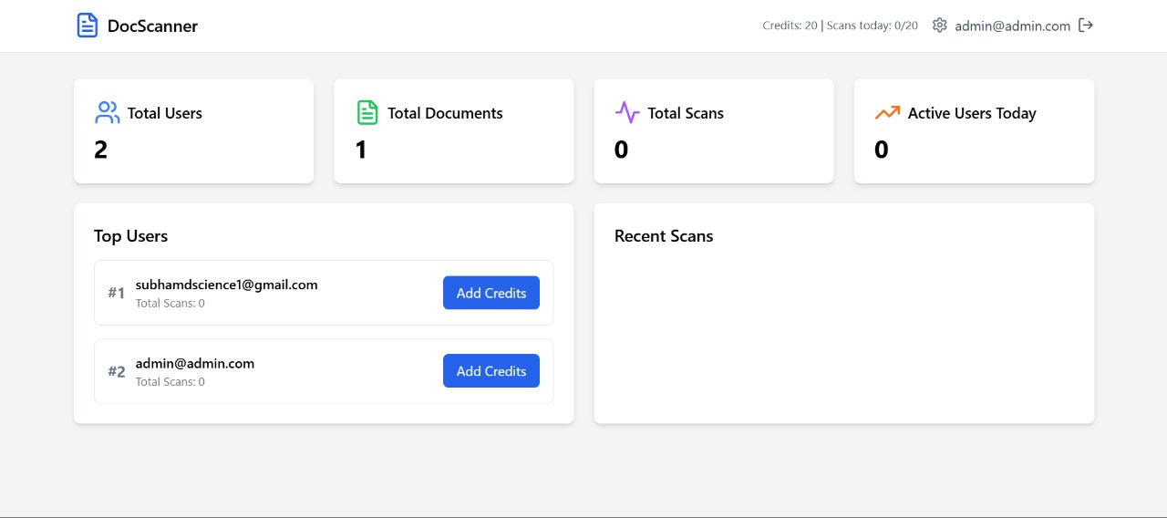
Admin Page Overview:-

Slide 7
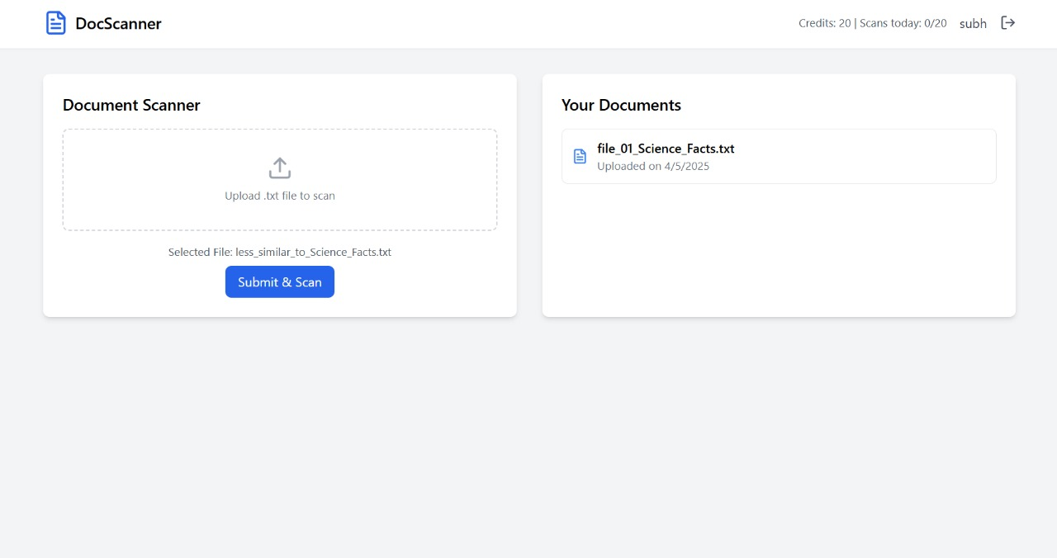
User Page Overview :-

Slide 8
Architecture;-
Frontend: React.js
Backend: Node.js and Express.js
NLP Matching Module
Cosine Similarity Algorithm: Detects changes, typos, and formatting differences. Results ranked by similarity score.
SQLite database for user, credit, and scan data
Gives Similarity

Slide 9
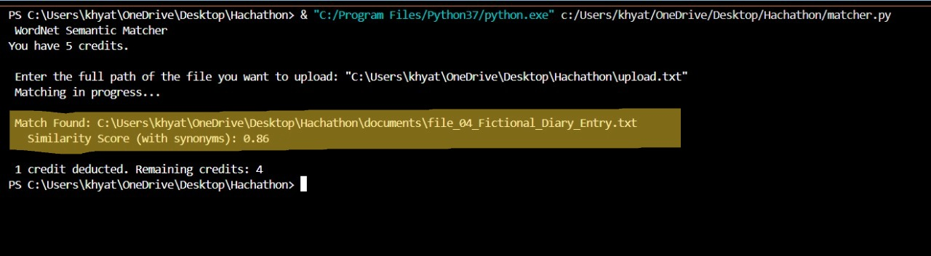
Model Code Outputs:
1. Successfully found the similar file:-

Slide 10
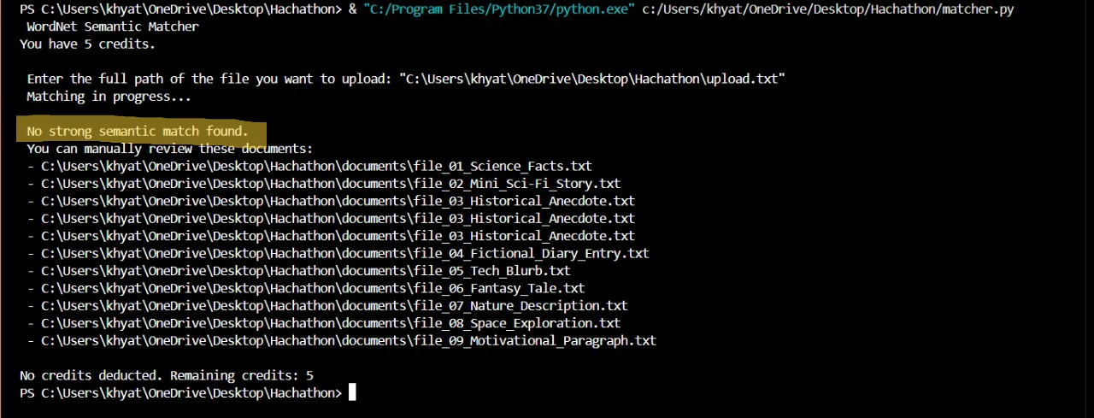
2. Not Found the Matching file:-

